Slide 1
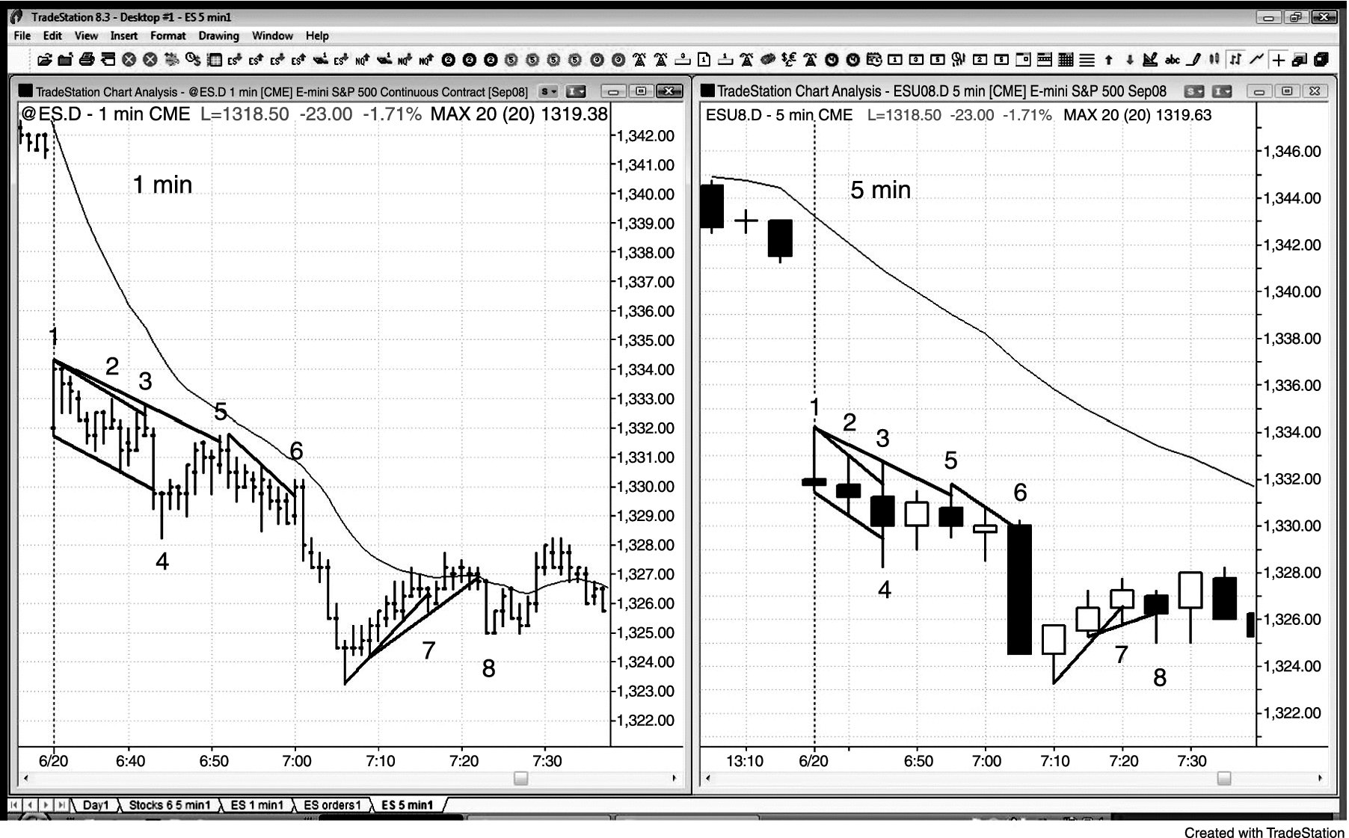
FIGURE 16.1 Micro Trend Lines

Slide 2
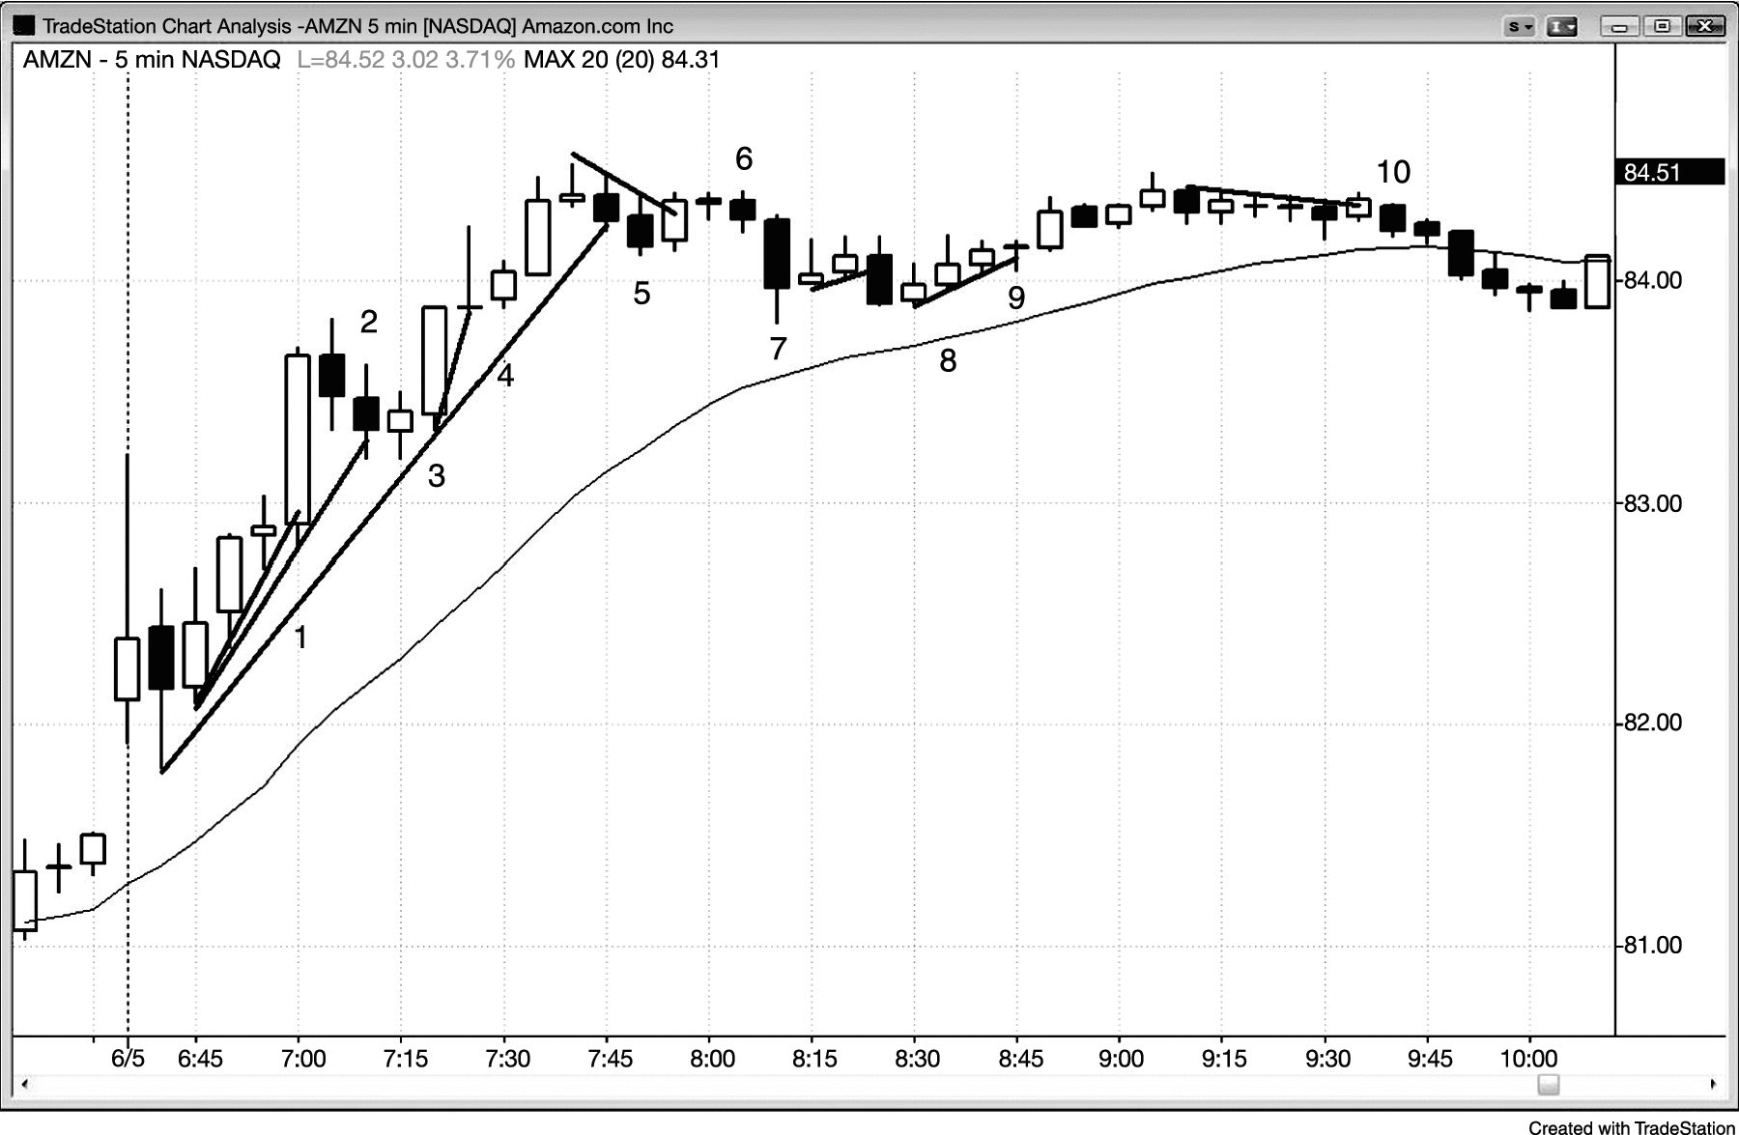
FIGURE 16.2 Failed Breakouts of Micro Trend Lines

Slide 3
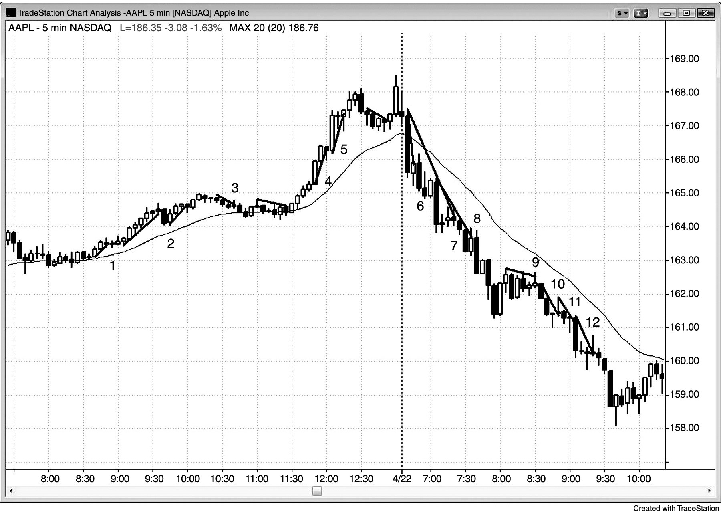
FIGURE 16.3 Micro Trend Lines in Strong Trends

Slide 4
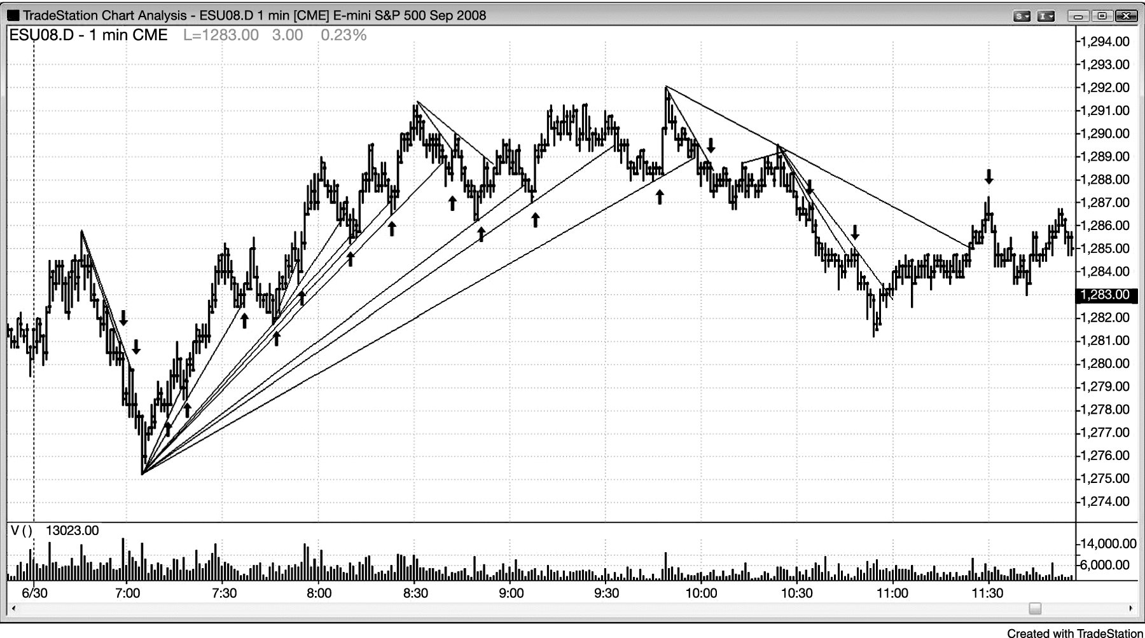
FIGURE 16.4 Micro Trend Lines Are Just Trend Lines on Smaller Time Frames

Slide 5
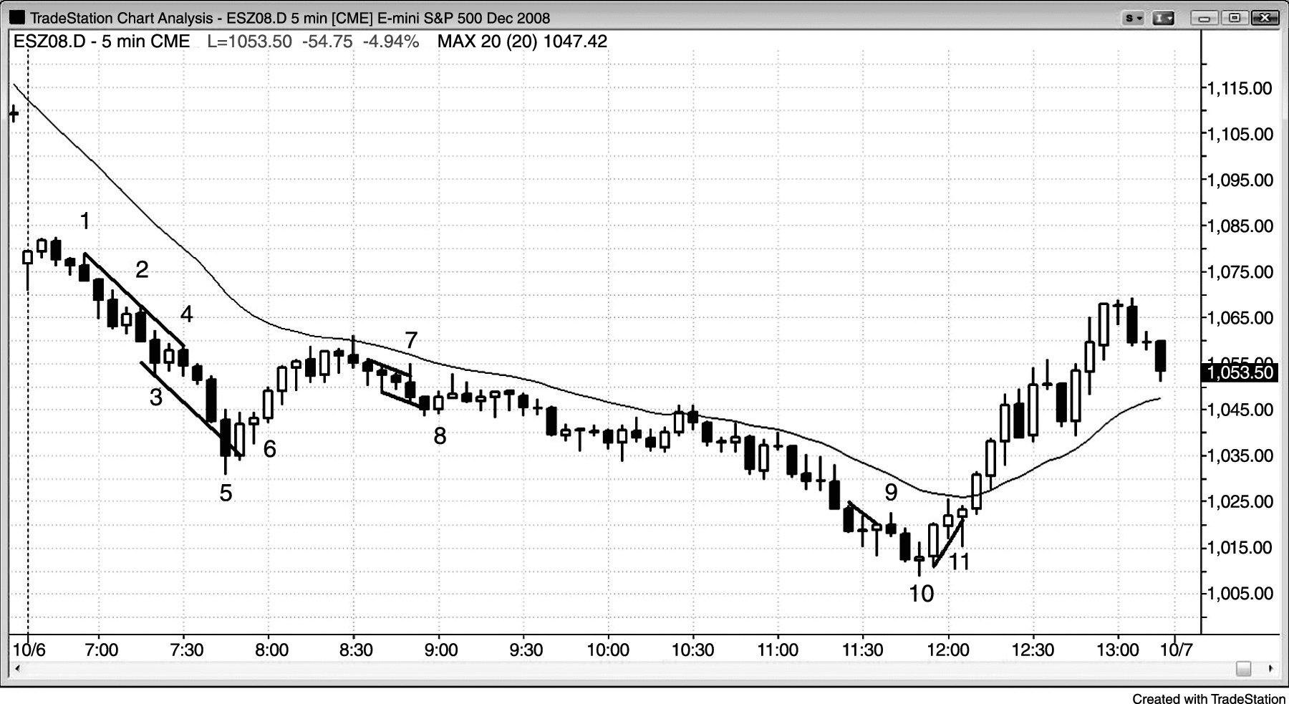
FIGURE 16.5 Micro Trend Lines When the Dow Is Down 700 Points

Slide 6
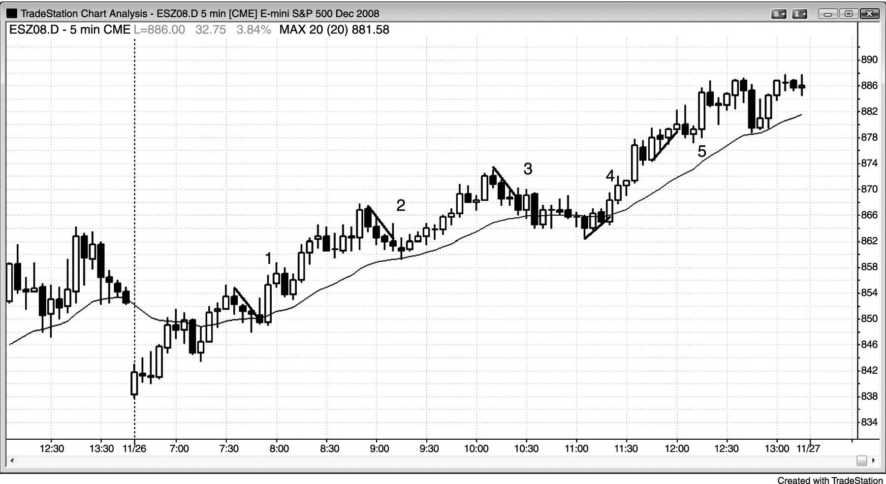
FIGURE 16.6 Micro Trend Lines in a Bull Trend

